Slide 1
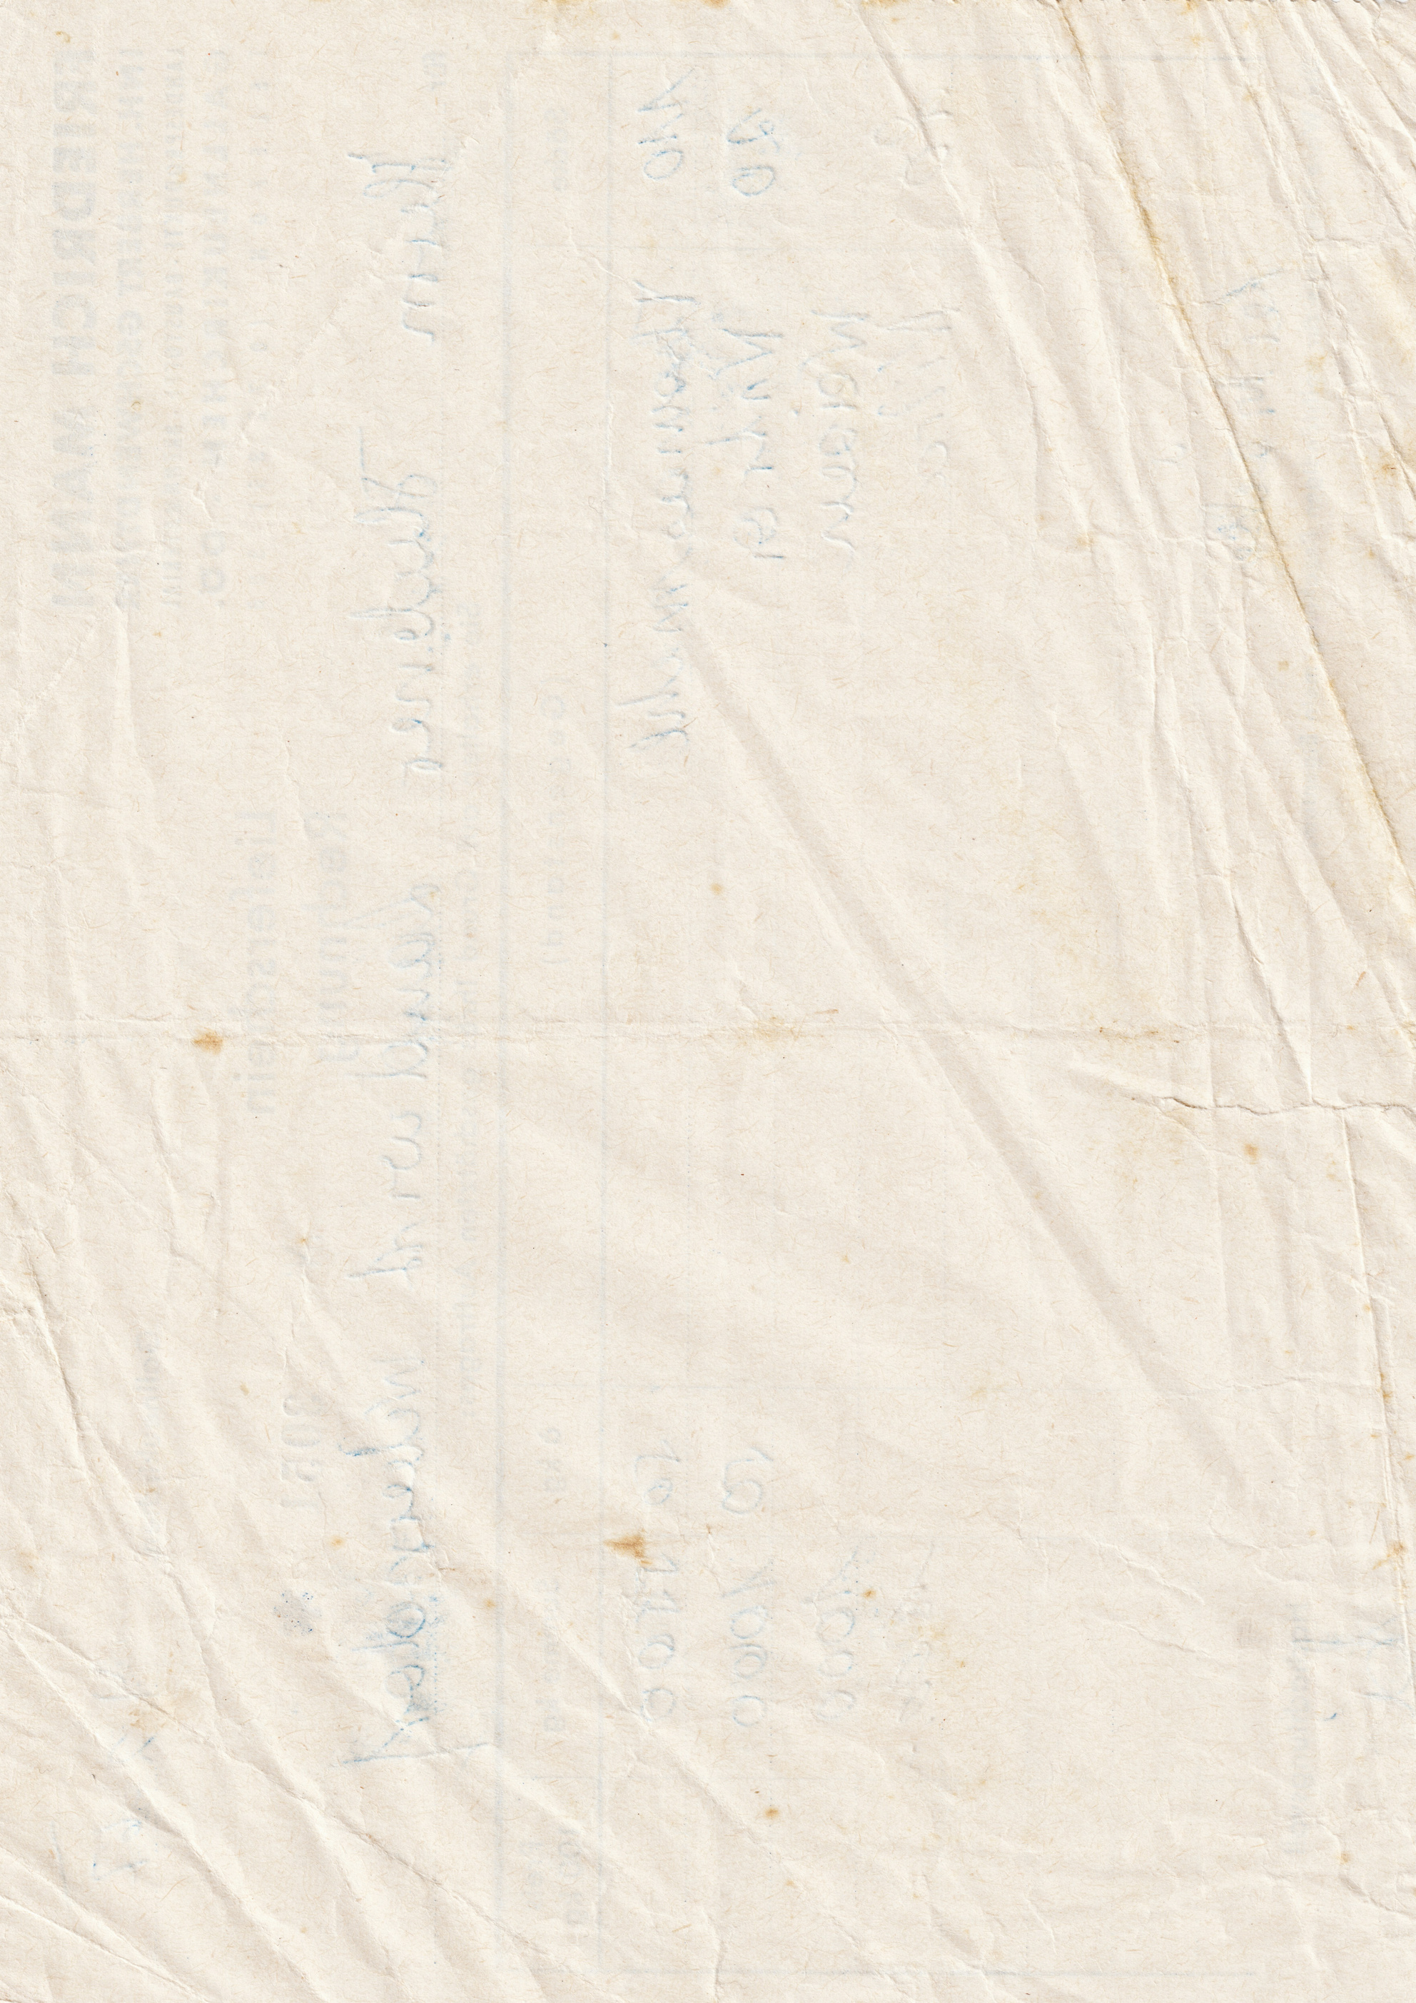
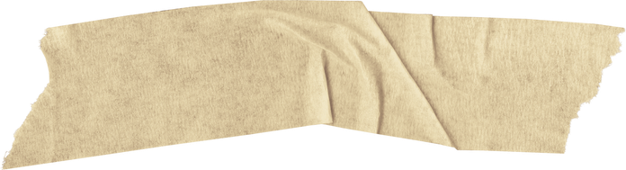
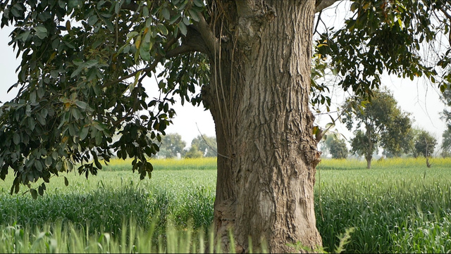
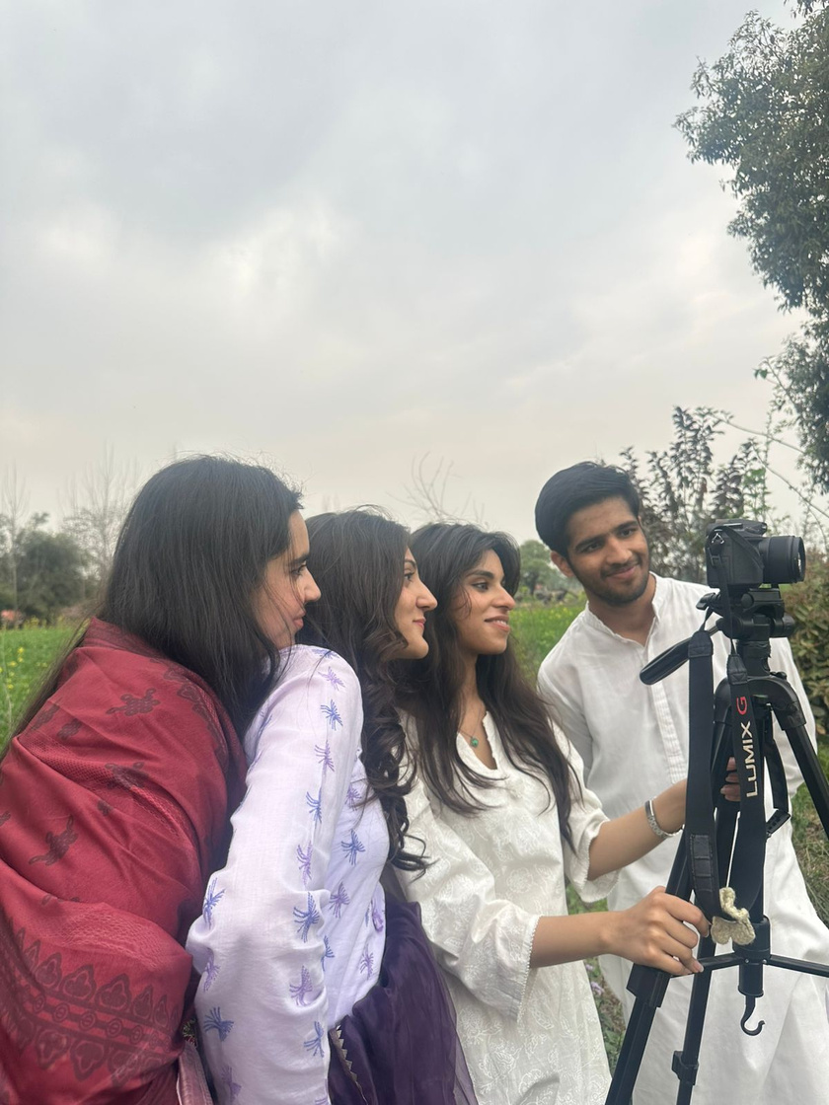
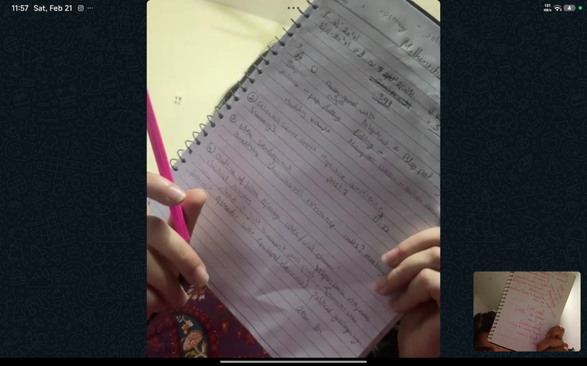

@REALLYGREATSITE
CCR 2
ATIFA NAEEM

Slide 2
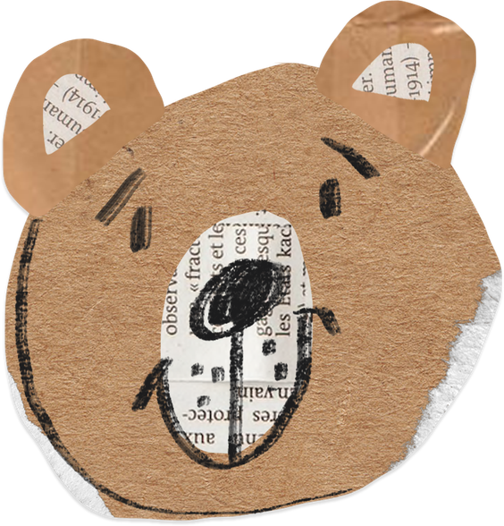


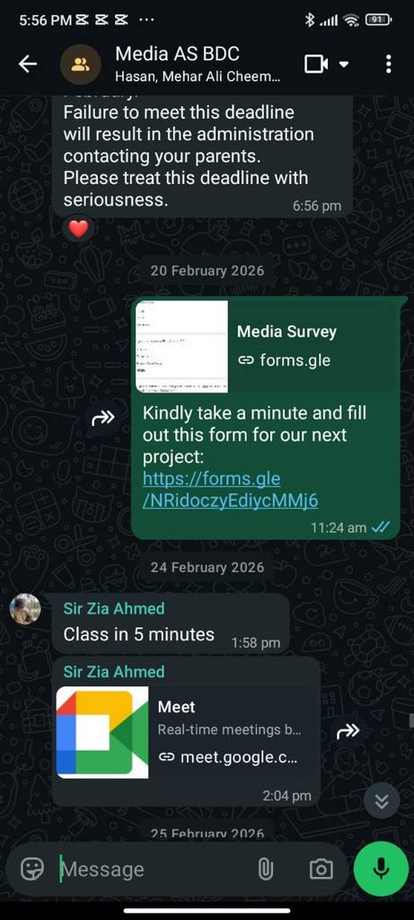
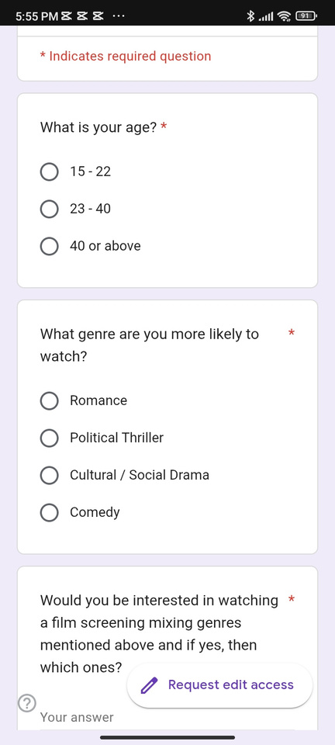

· How does your product engage with audiences and how would it be distributed as a real media text?
BEFORE WE BEGUN WITH THE PROJECT, WE CONDUCTED A GOOGLE FORM ONLINE. THIS FORM INCLUDED VARIOUS QUESTIONS ABOUT PREFERRED GENRES, AGE GROUPS AND OTHER CHARACTERISTICS. THE POINT WAS TO GET TO KNOW OUR AUDIENCE BETTER. WE REACHED OUT TO PEOPLE ON VARIOUS SOCIAL MEDIA PLATFORMS (INSTAGRAM, TWITTER AND WHATSAPP)

Slide 3
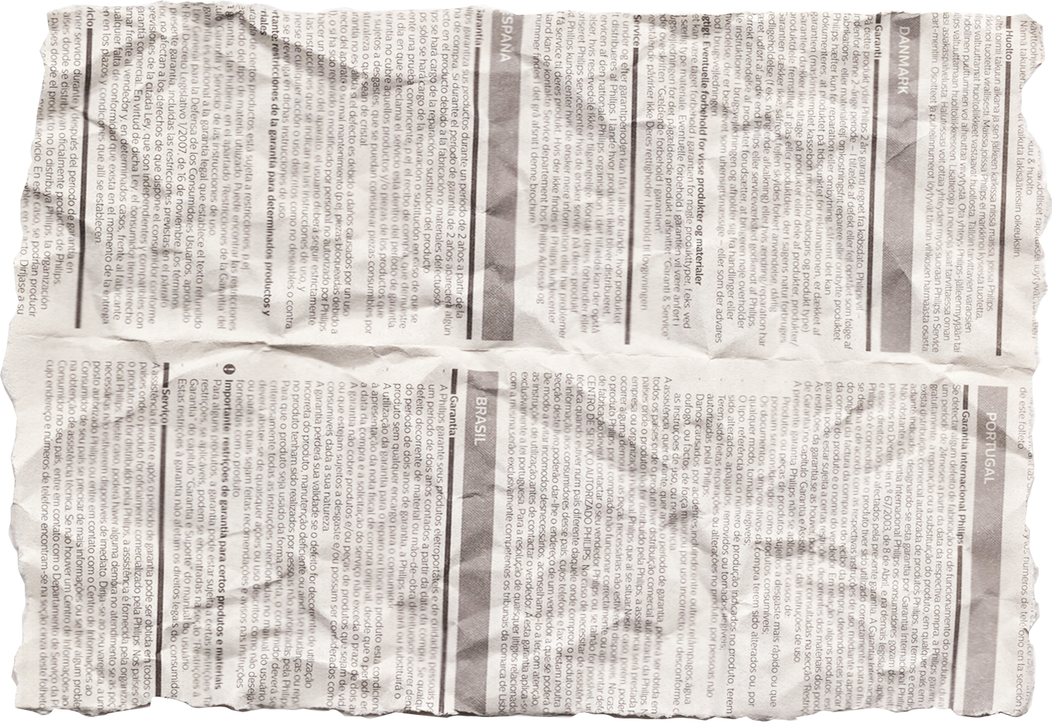

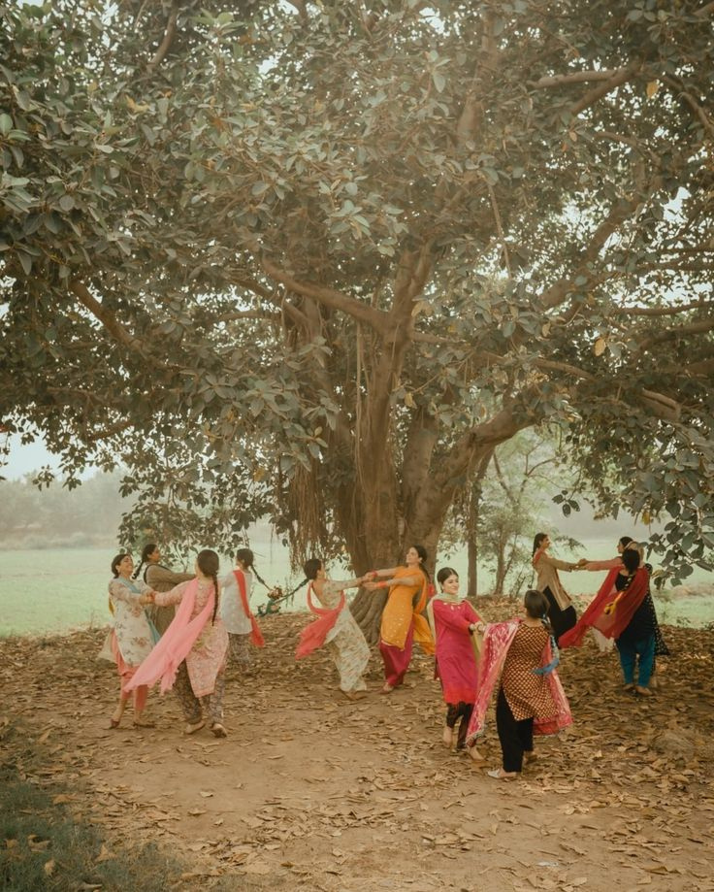
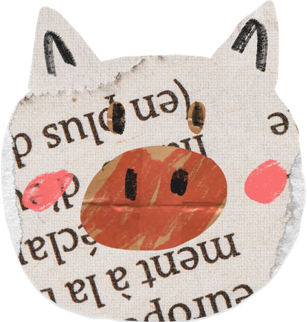
Here’s what we got:
WHAT DO PEOPLE LOVE?
AFTER A THOROUGH CHECK, WE CAME TO A CONCLUSION THAT WE ARE CATERING TO YOUNG ADULTS, WHO LOVE ROMANCE AND POLITICAL DRAMAS. HENCE, OUR STORY REVOLVED AROUND THAT THEME. OUR AUDIENCE WIDELY USED INSTAGRAM

Slide 4

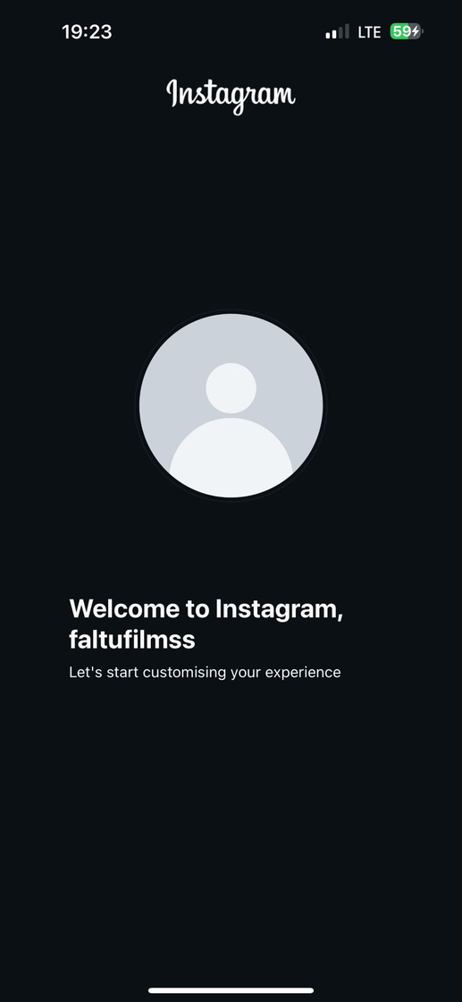

INTERACTING ON SOCIAL MEDIA
MISSION ACCOMPLISHED
INSTAGRAM
OUR NEW GEN AUDIENCE WAS ON INSTAGRAM (92%) HENCE, WE MADE AN INSTAGRAM ACCOUNT @FALTUFILMSS TO REACH OUT TO THEM. WE POSTED REELS ALMOST DAILY TO WIDEN OUR AUDIENCE. WE ALSO CONDUCTED QUITE A FEW Q&AS.
OUR REACH WENT UPTO 10K IN A WEEK.

Slide 5
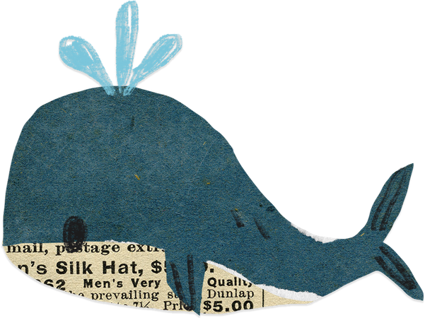
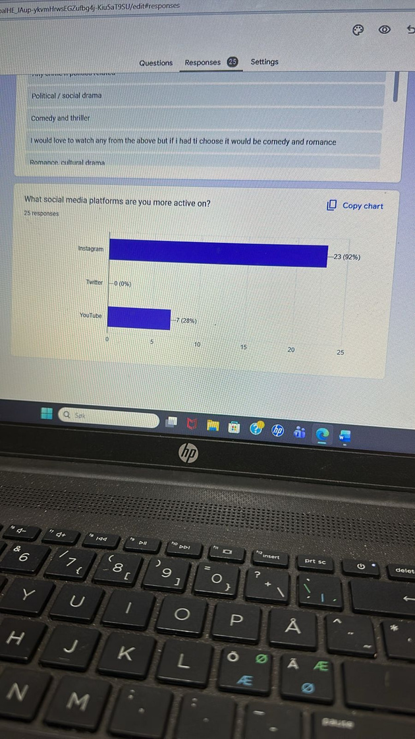
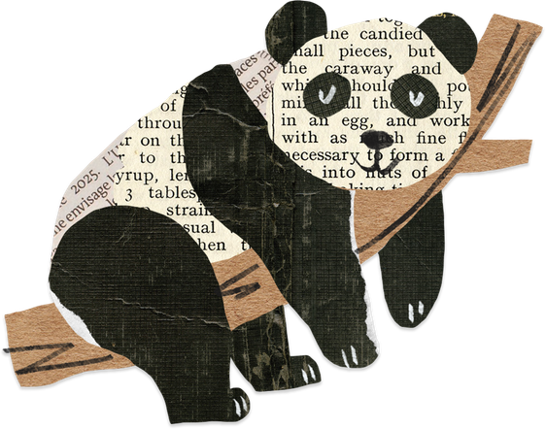

LINKS
TO IT ALL
HTTPS://WWW.INSTAGRAM.COM/FALTUFILMSS?IGSH=MWNOYWHZCWZRDGVIEQ==
HTTPS://DOCS.GOOGLE.COM/FORMS/D/1N7-AGBALHE_JAUP-YKVMHRWSEGZUFBG4J-KIU5AT9SU/VIEWFORM?EDIT_REQUESTED=TRUE#RESPONSES

Slide 6
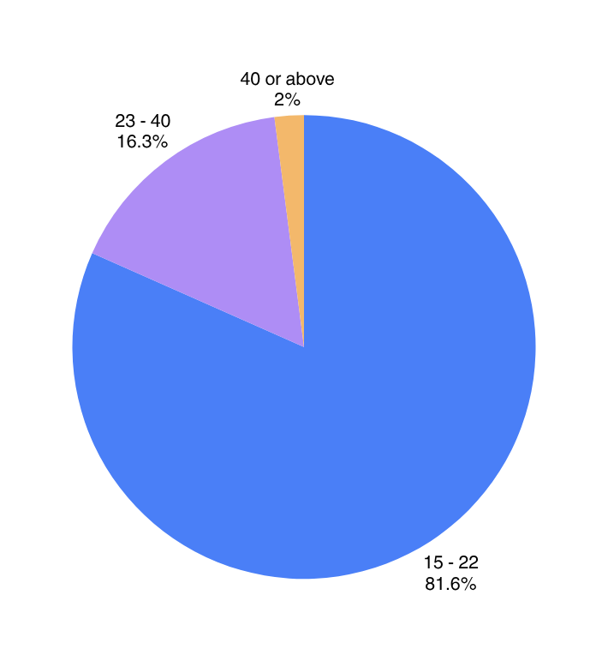
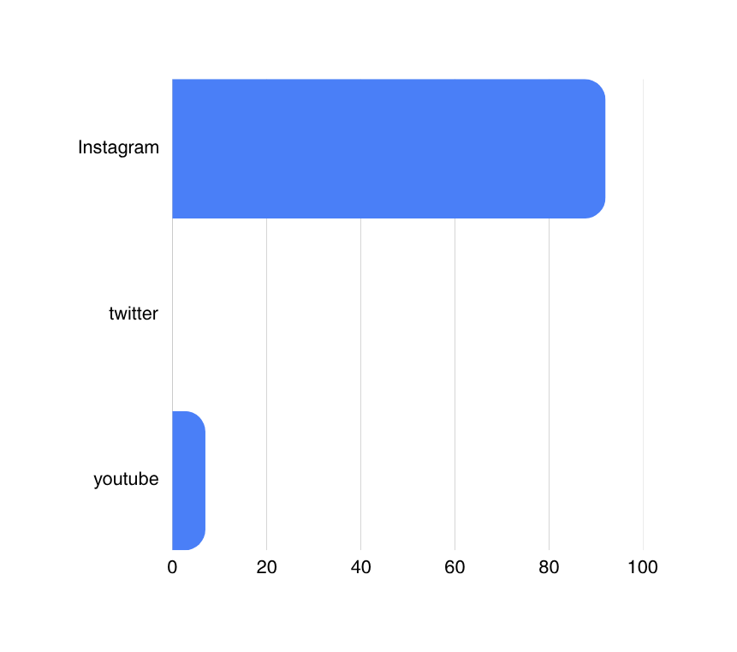
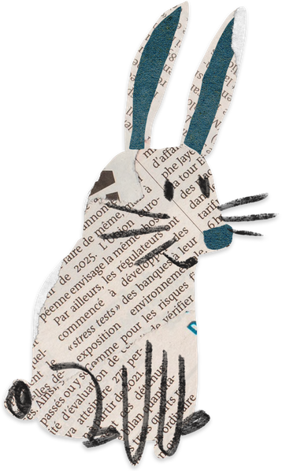
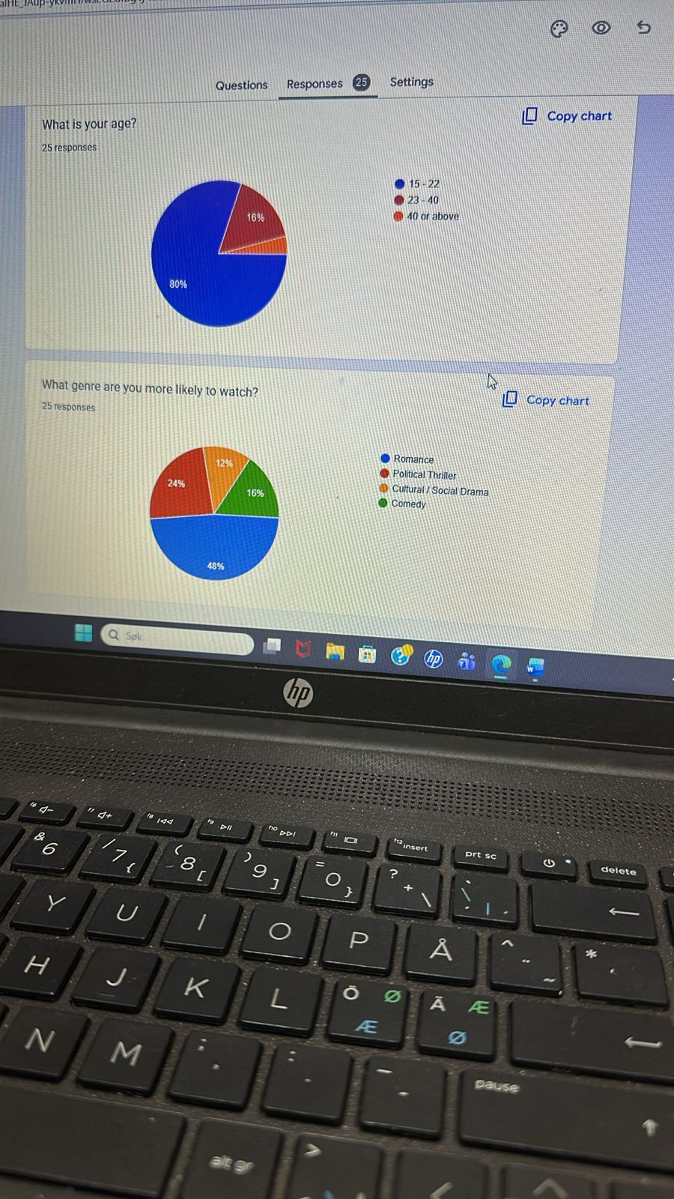
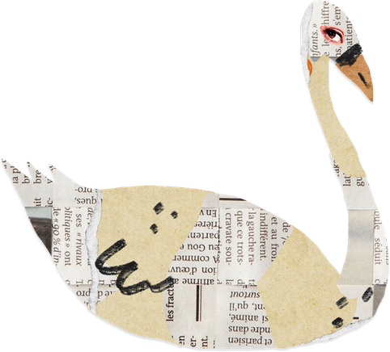
Results

Slide 7

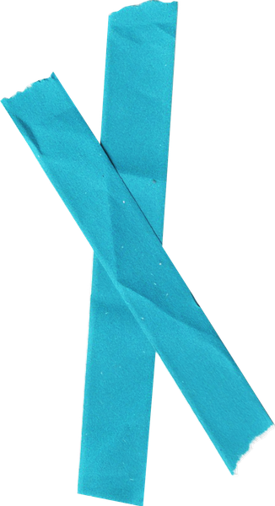
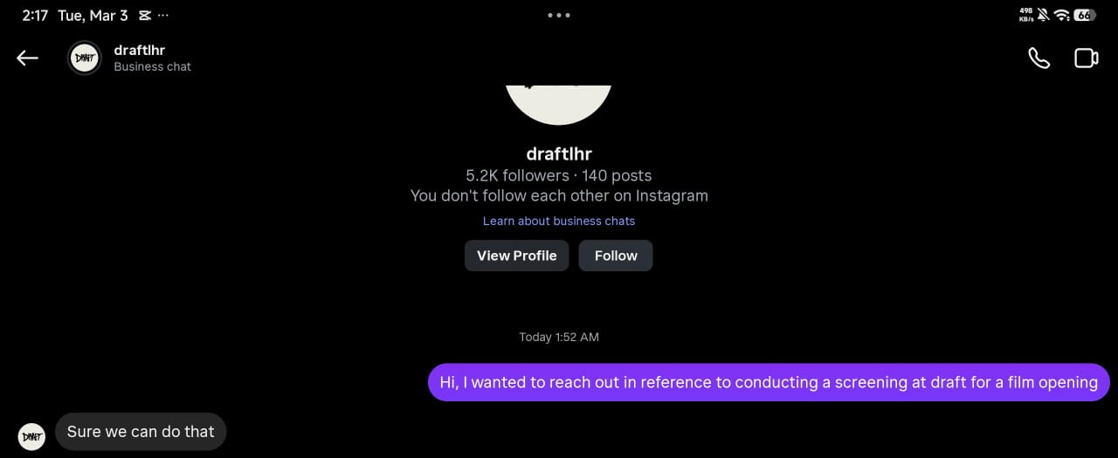
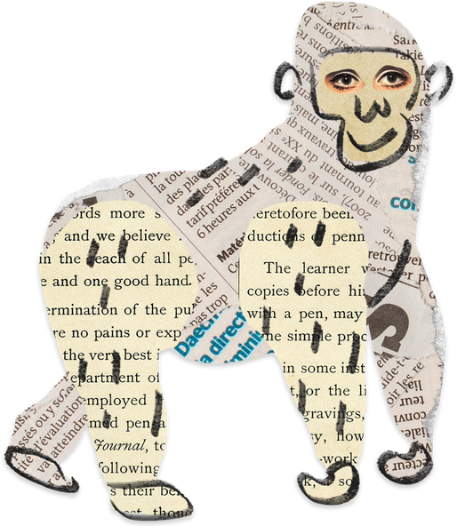

WE ALSO REACHED OUT TO A FEW CAFES REGARDING HOSTING A SCREENING OF THE FILM COMMERCIALLY AND WE GOT A REALLY GOOD RESPONSE
Screening

Slide 8


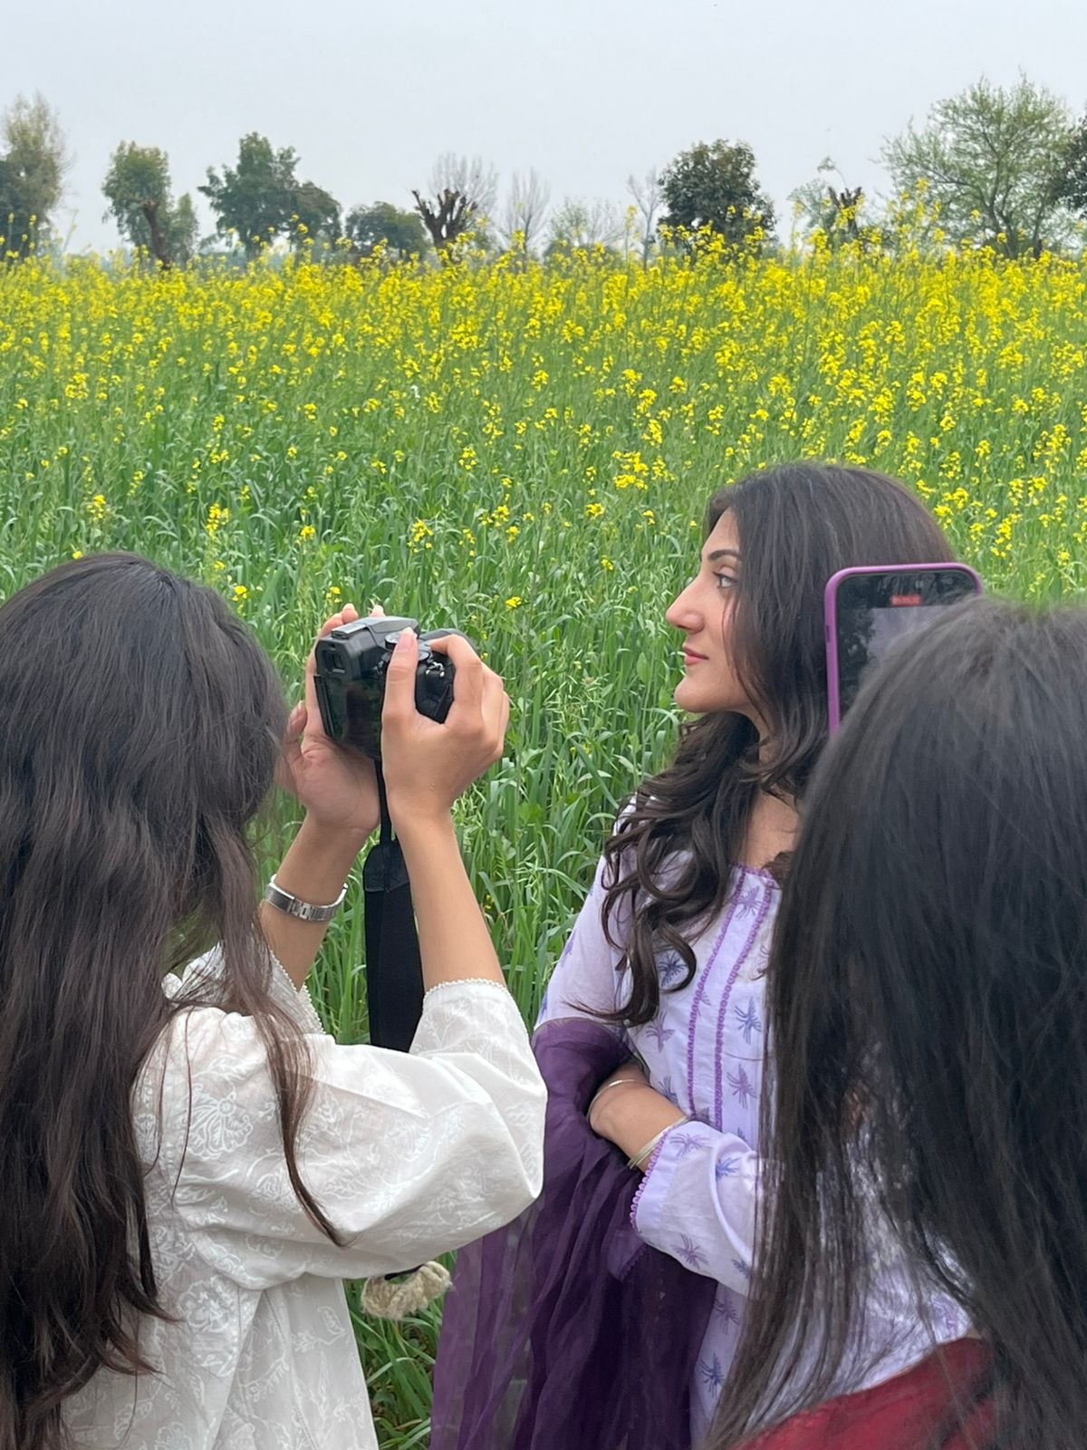

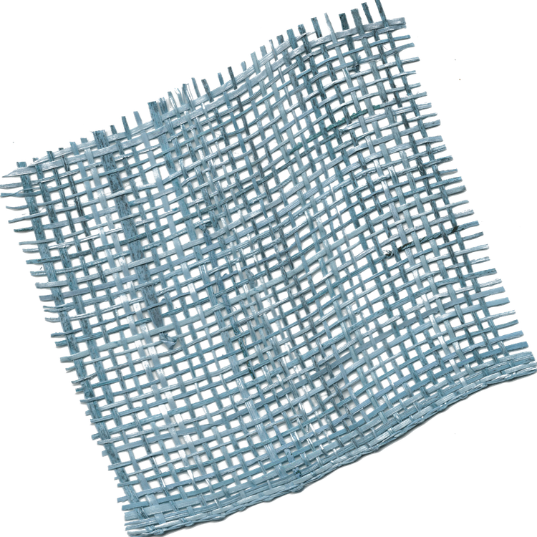
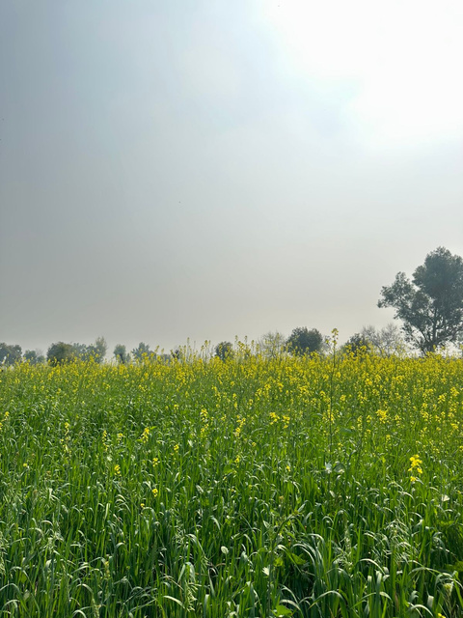

CONCLUDING
OUR PRODUCT IS BASED ON AUDIENCE CHOICE HENCE, IT HAS MORE APPEAL TO IT. NOT ONLY THE STORYLINE BUT THE PROMOTION WAS ALSO DONE AFTER VARIOUS MARKET AND AUDIENCE RESEARCH TO CATER TO THEIR NEEDS.
OUR ENTIRE PROCESS FROM BEGINNING, MIDDLE AND END HAS BEEN ASSURED BY AUDIENCE AROUND PAKISTAN NOT JUST LAHORE. BUILDING CURIOSITY AND MAKING SURE OUR CONSUMERS ARE GIVEN ALL THE COMFORT AND INFORMATION ABOUT THE PROCESS.

Slide 9
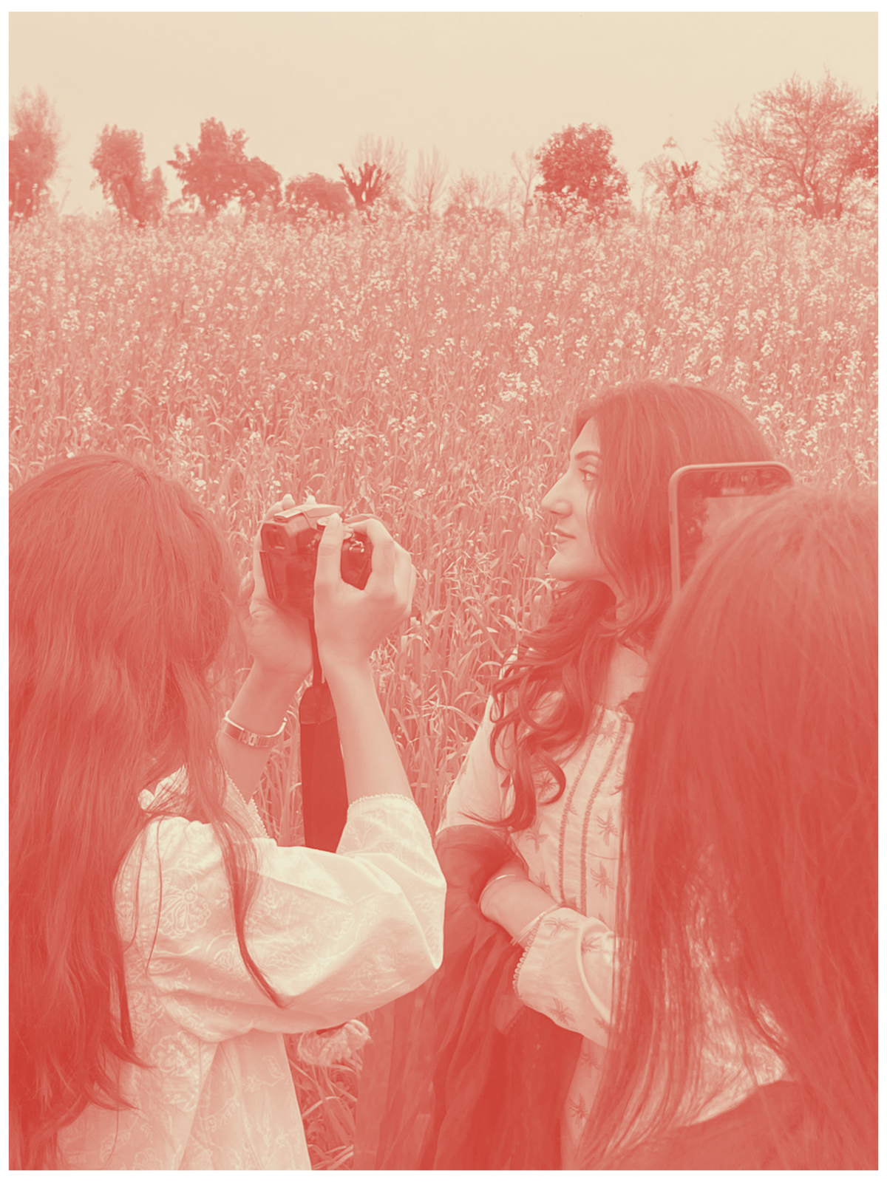

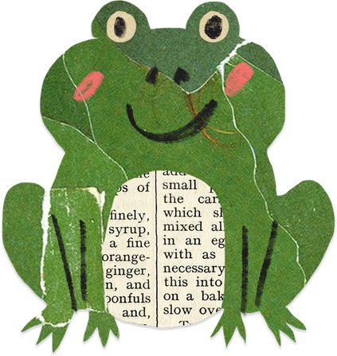
ATIFA NAEEM
THANK YOU
CAN I HAVE AN A GRADE NOW?

